Slide 1
The effects of Covid-19 on air transportation
ebay-espresso
Conor Aitken, Damini Patel, Diane Yaneza,
Faisal Mali, Jayne Horton, Mwansa Mwango

Slide 2
Hypothesis and Questions
Our expectation was that air travel by passengers would be substantially reduced by restrictions on travel, and that airlines would find alternate ways to maintain maximum usage of planes.
Which countries were planes coming into Australia from?
What were the numbers of passengers arriving to and departing from Australia?
What was the amount of freight and mail in and out of Australia?
What were the ratios of passengers to freight per flight?
Did any airlines stop servicing Australia in 2020?

Slide 3
Data
We wanted to use ten years of historical data to show prior pattens
Origin and destinations of all flights
Passengers, freight and mail volumes
Each of these over a 10 year period
Bureau of Infrastructure and Transport (BITRE) - two data files
Definitions of freight and mail were unclear so we reached out to BITRE to define. Mail is anything carried by Australia Post and freight is anything else.

Slide 4
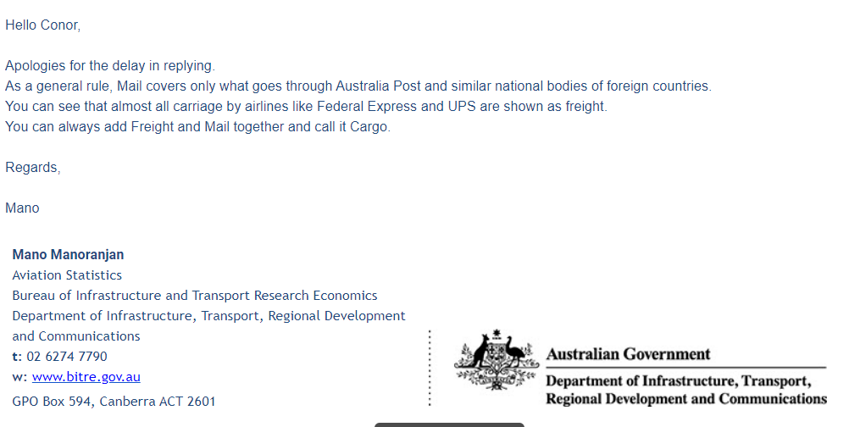

Slide 5

Exploration & Cleaning
Explored a few options before settling on air traffic as finding data was challenging for some of the topics considered
Considered exploring the financial implications however international figures were unavailable
Files contained airline information in one and volumes of passengers, freight & mail in another
CSV files were set as ‘Human readable’ for excel use – cleaning involved removing dead space to make the files usable for pandas
Numeric data needed to be converted from strings to floats

Slide 6

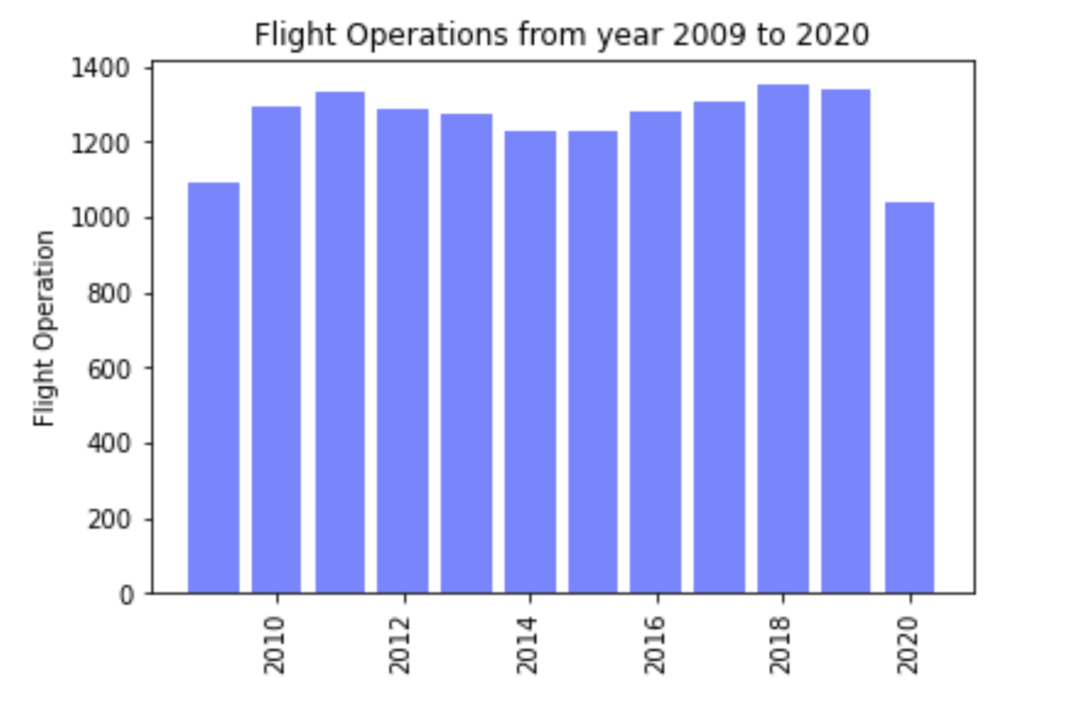

Which countries were planes coming into Australia from?
2009 – 2020 there 51 countries for the full data set
2019 there were 35 countries
2020 37 countries

Slide 7
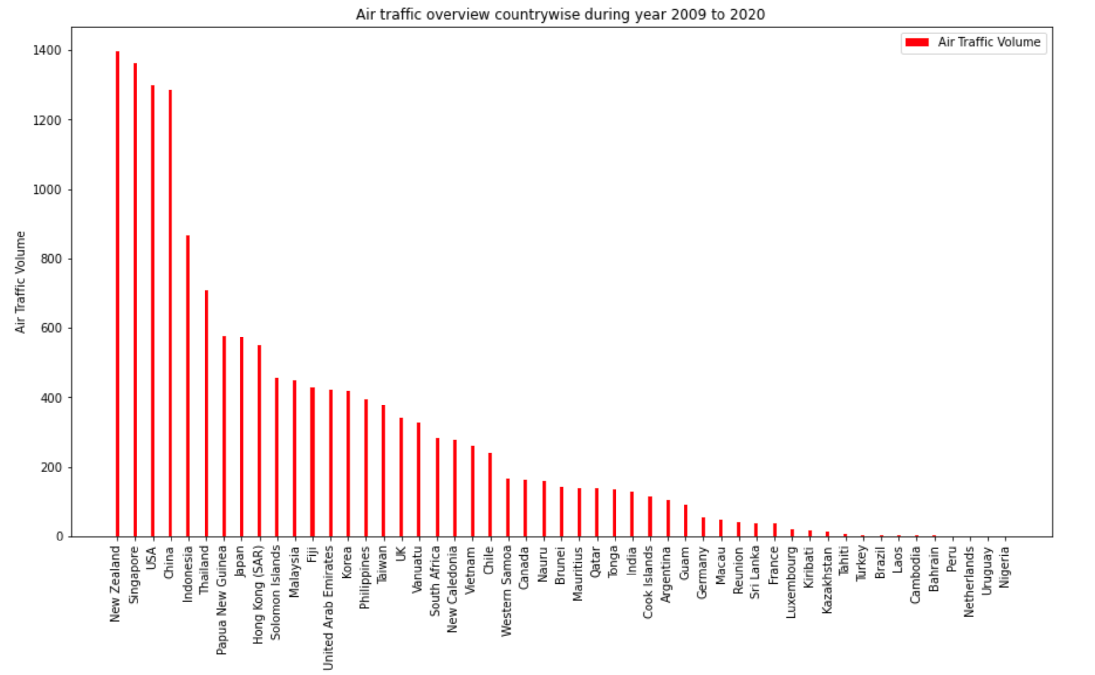

Slide 8
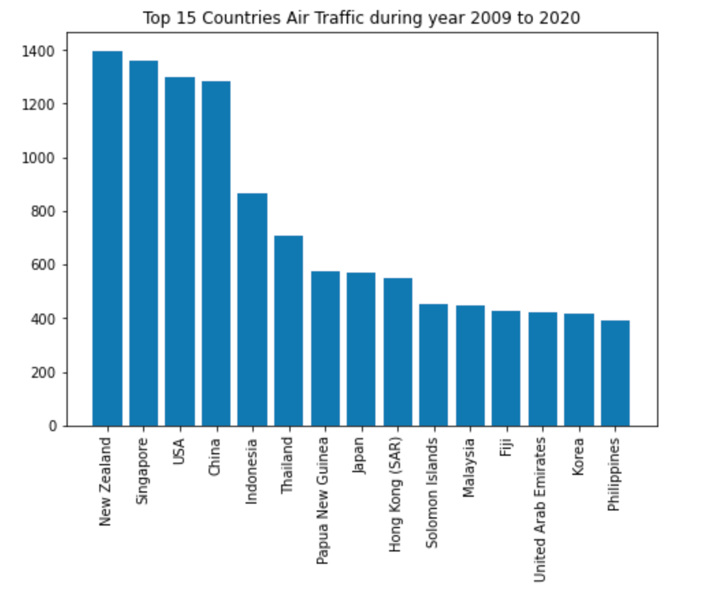

Slide 9
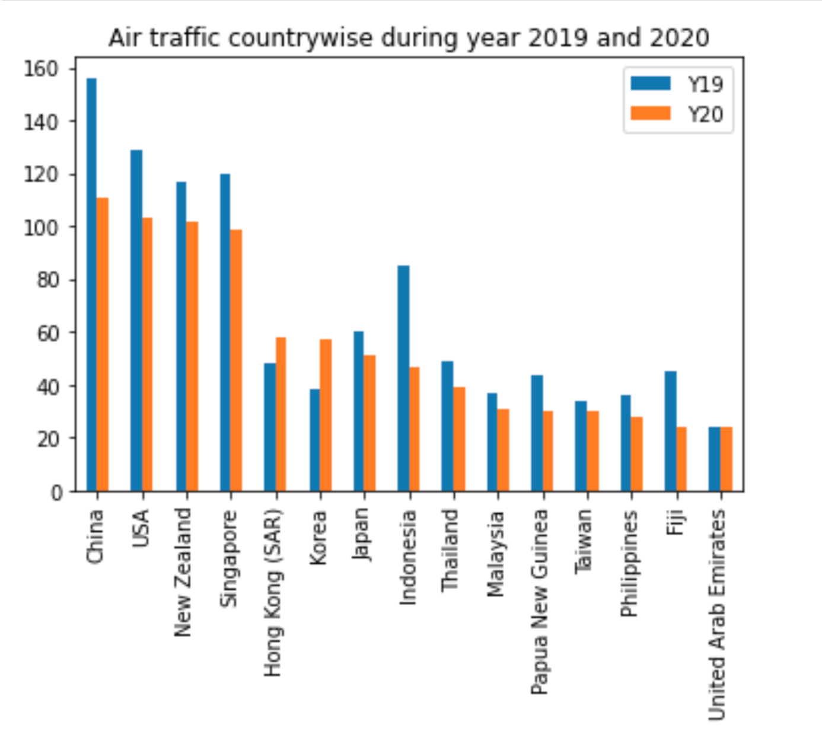

Slide 10
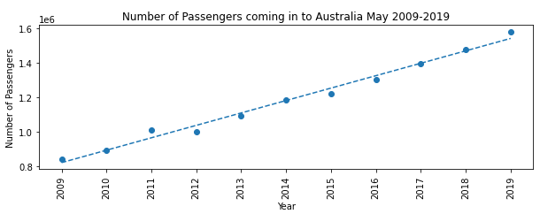
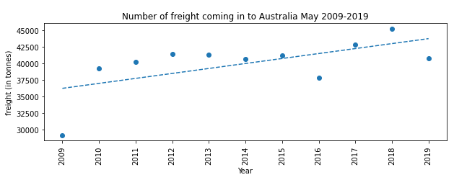
Passengers In

Slide 11
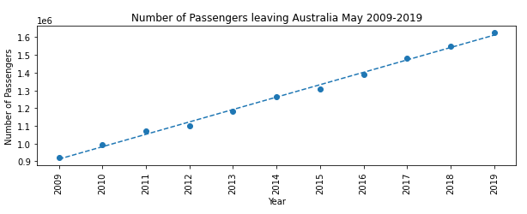
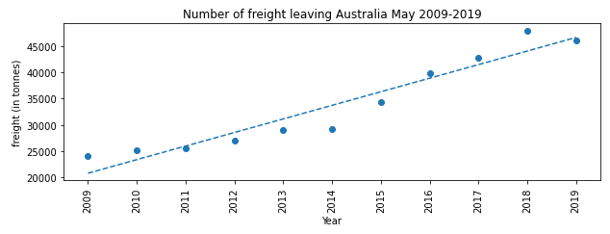
Passengers Out

Slide 12
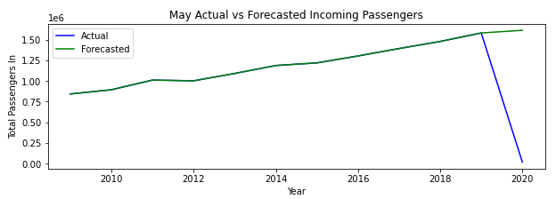
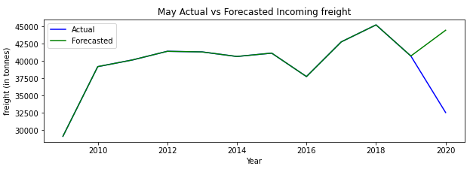
Passengers In Projected

Slide 13
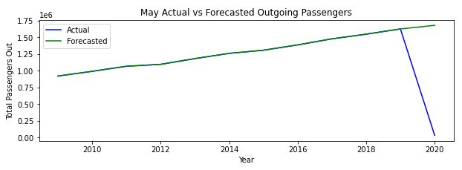
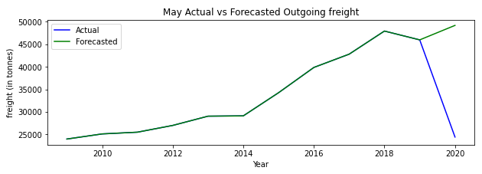
Passengers Out Projected

Slide 14
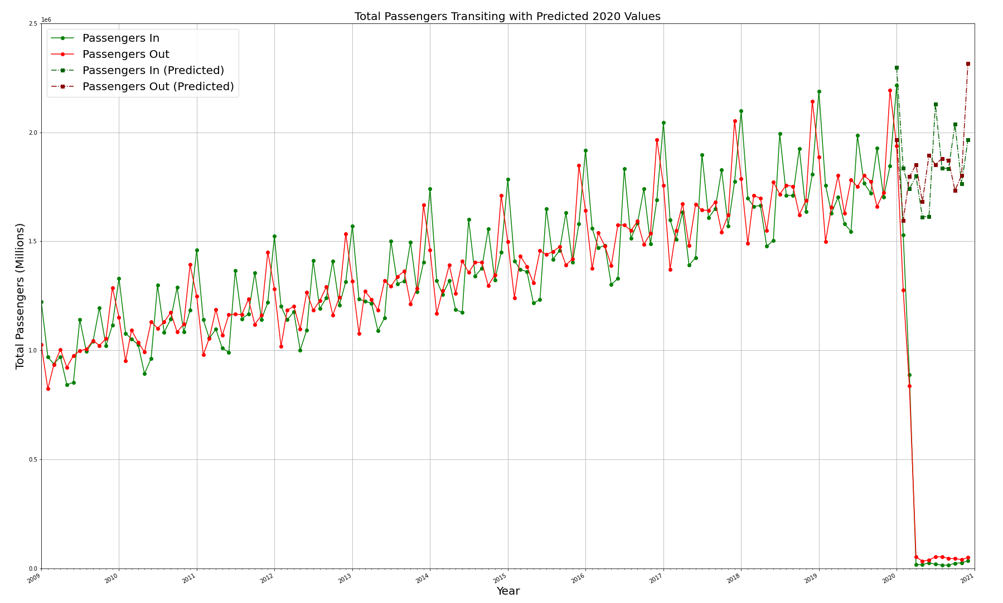

Slide 15
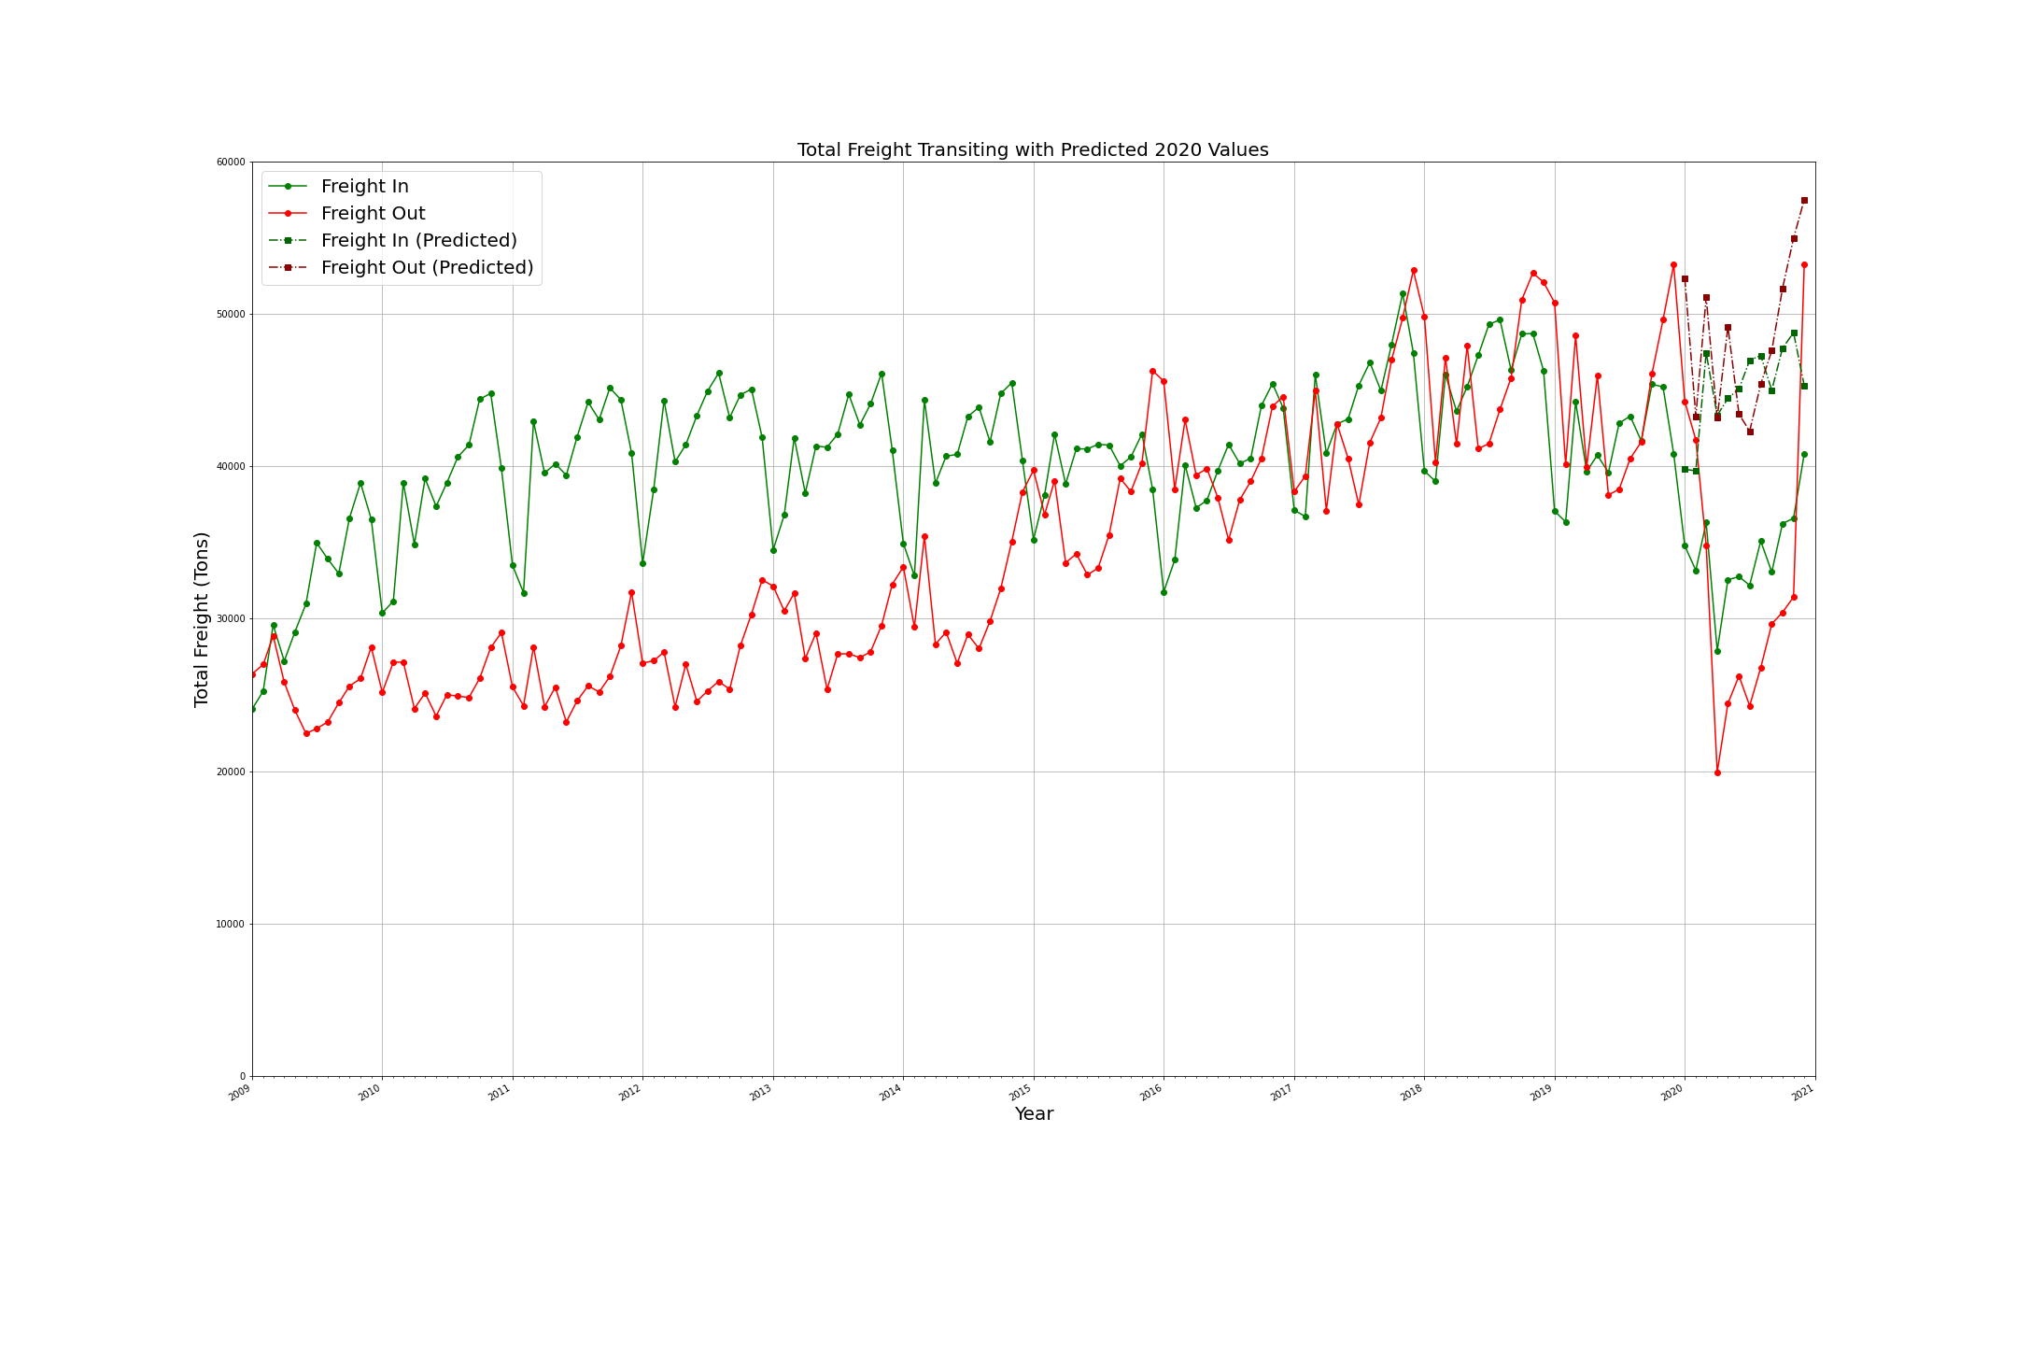

Slide 16
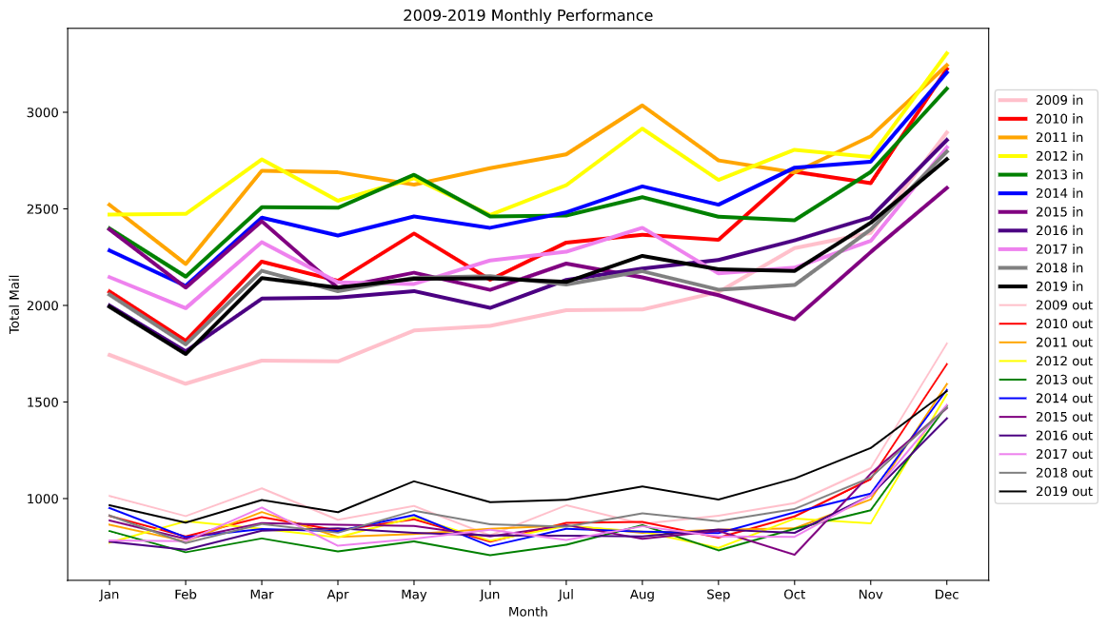
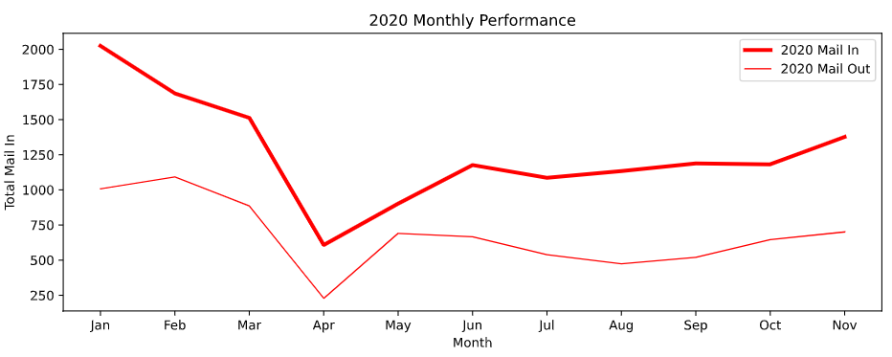

Slide 17
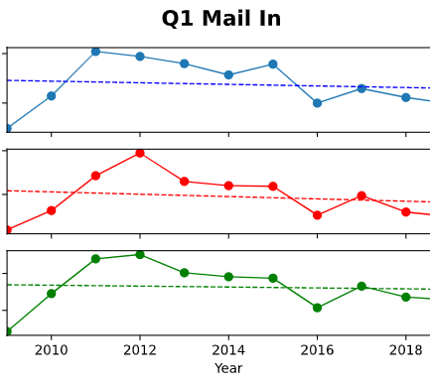

Slide 18
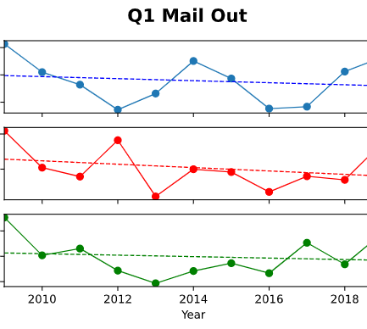

Slide 19
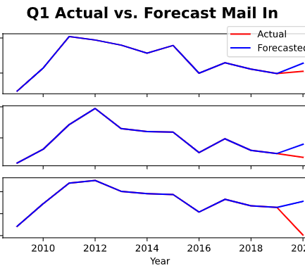

Slide 20
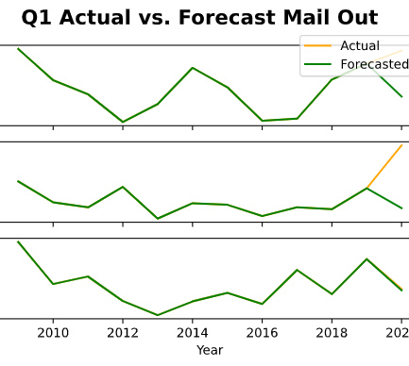

Slide 21
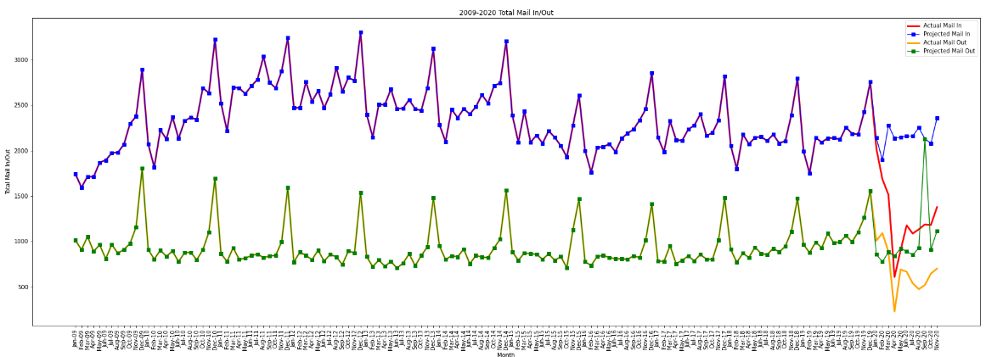

Slide 22
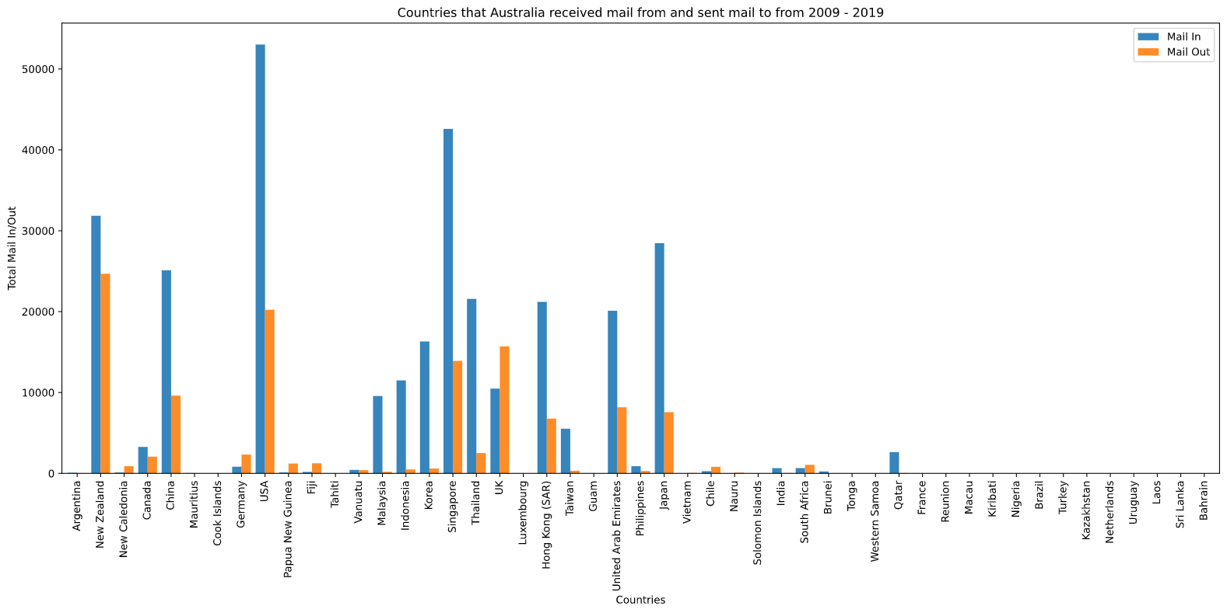

Slide 23
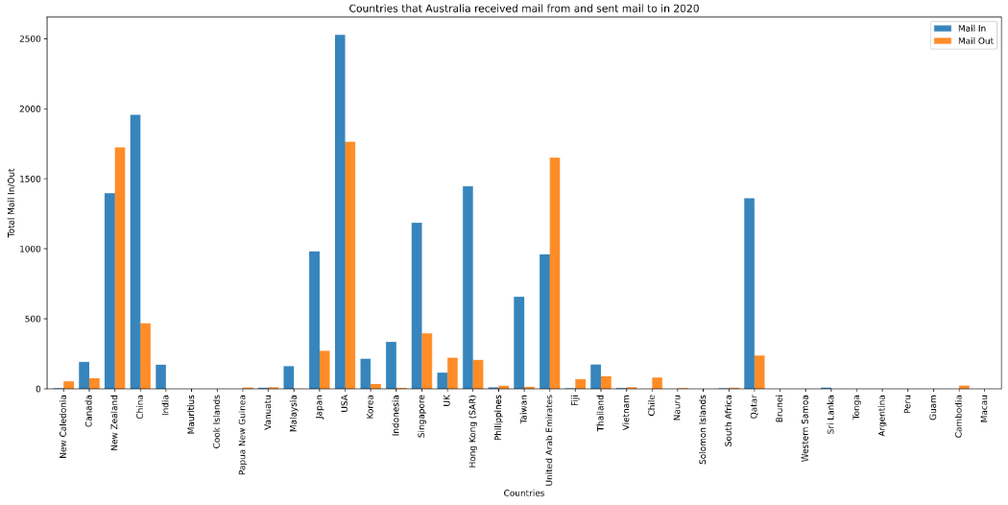

Slide 24
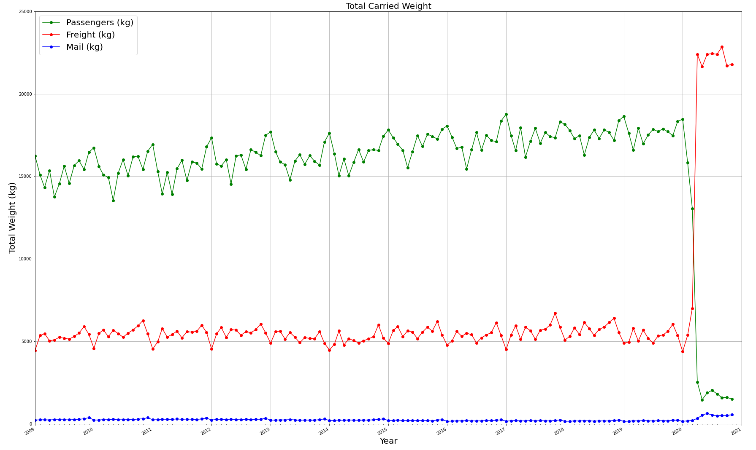

Slide 25
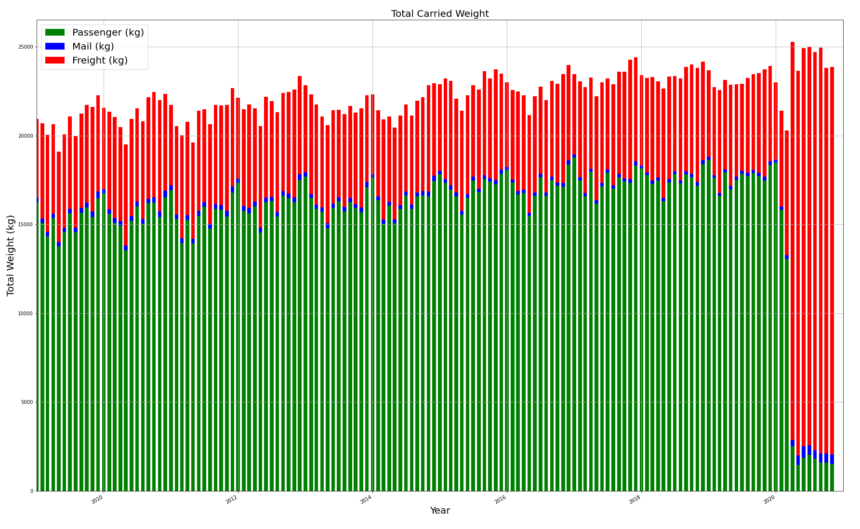

Slide 26
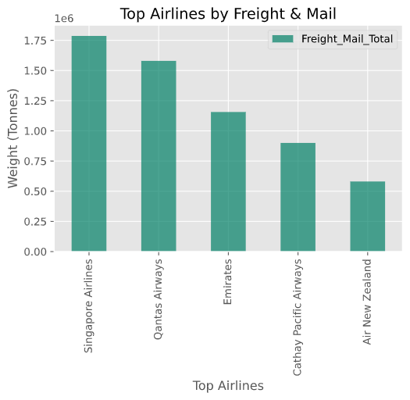

Slide 27
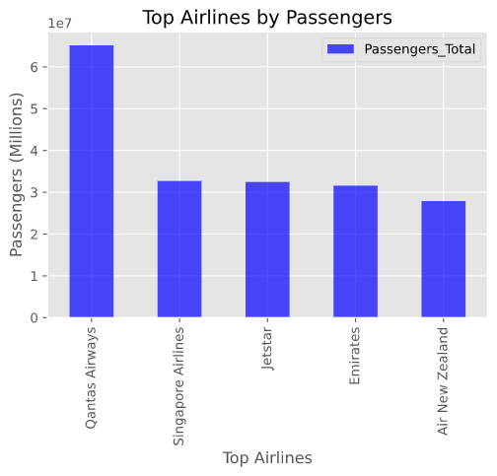

Slide 28
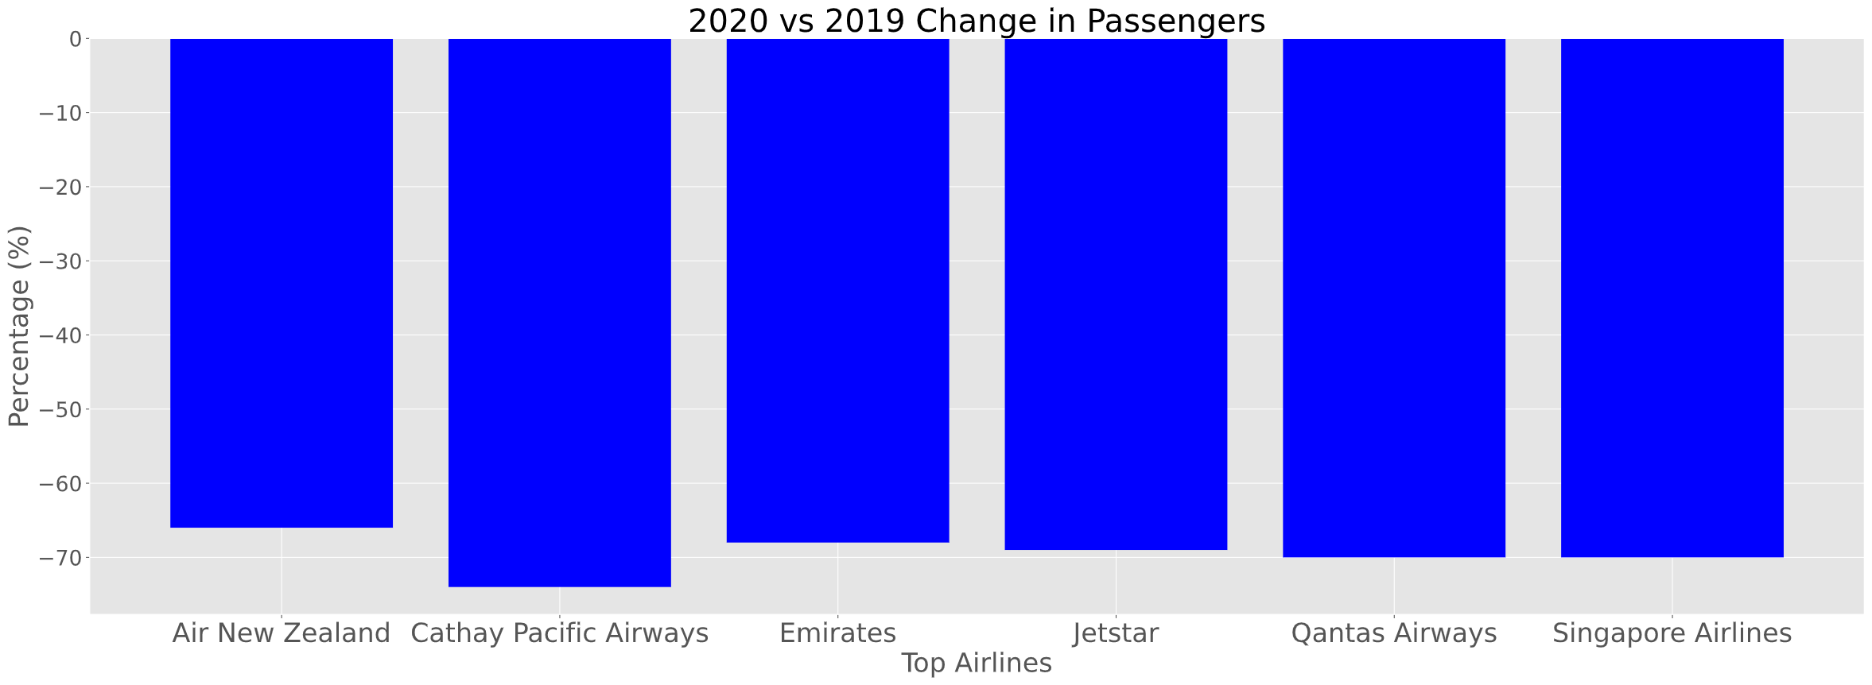
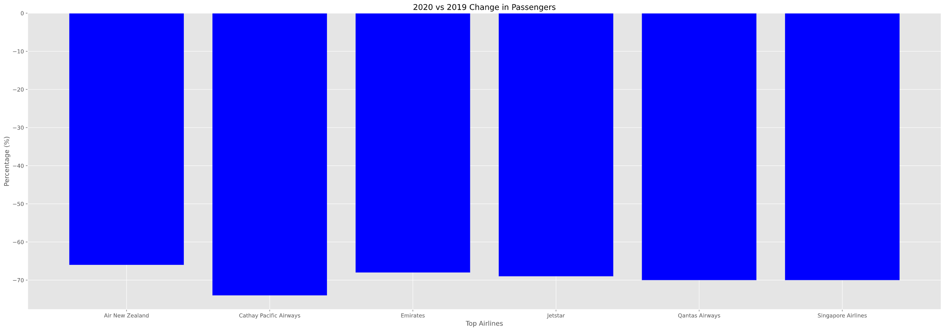
Changes in Passengers

Slide 29
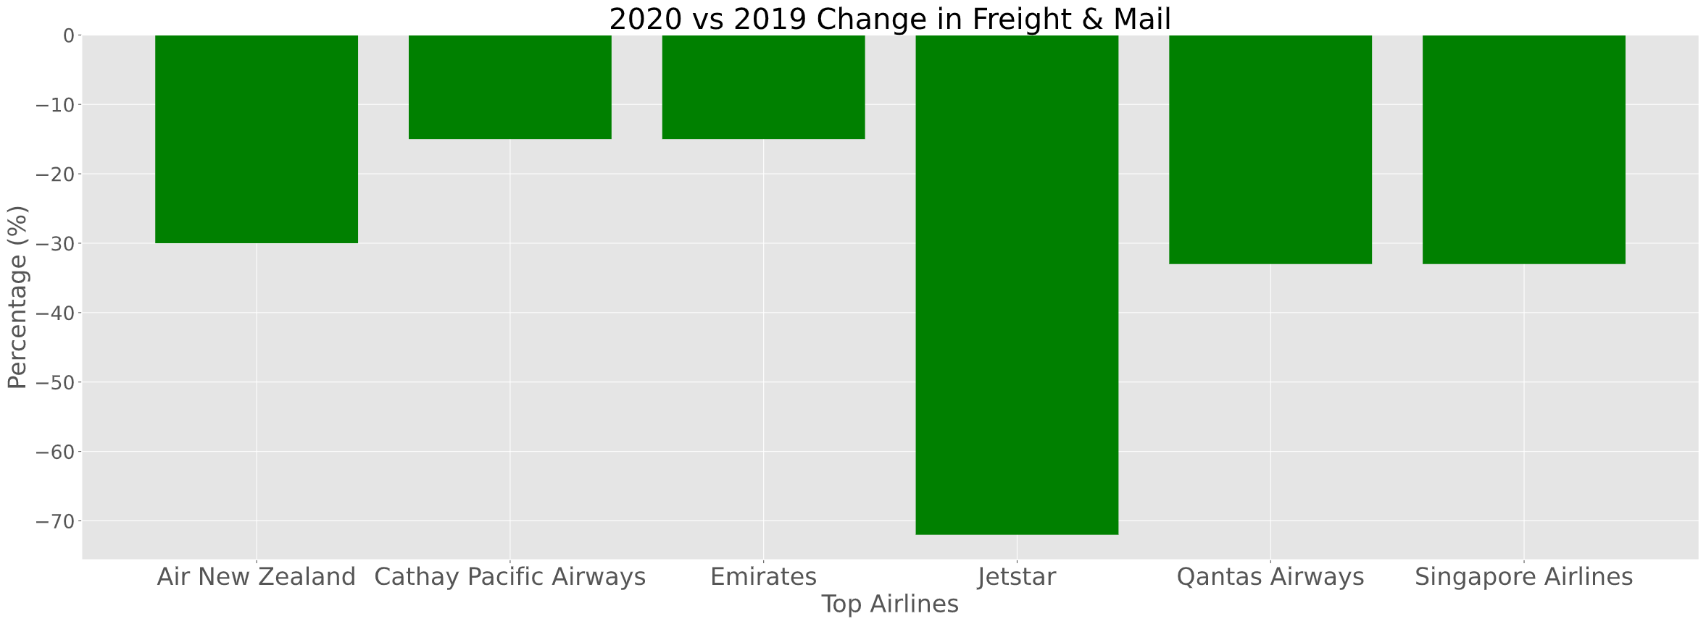
Changes in Cargo

Slide 30
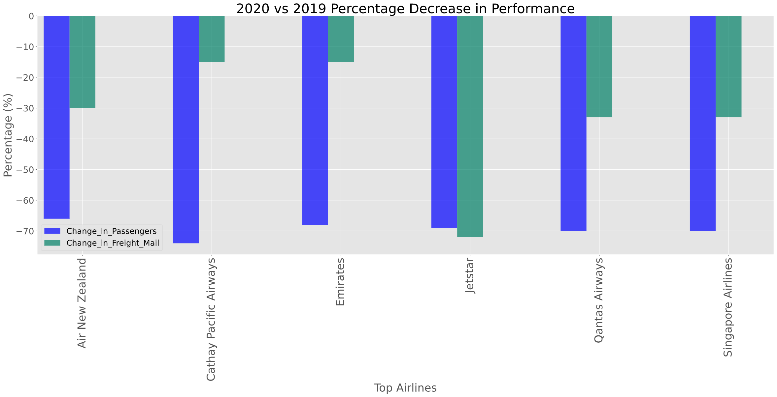
Changes in Passengers and Cargo

Slide 31
Conclusions
Additional questions we would have explored with more time?
For passengers and freight we would have investigated the reason for positive and negative spikes in off season
We would have investigated the financial implications of the drop in air traffic from the start of Covid
Investigated the different aircraft to understand the weight limitations

